Slide 1
Employee Data Analysis using Excel
STUDENT NAME: NEHA JAIN R
REGISTER NO: 312210406, 464C93501EA69F0AA5E4ABDF38F27D6D
DEPARTMENT: B.COM GENERALS
COLLEGE: GURUSHREE SHANTIVIJAI COLLEGE FOR WOMEN

Slide 2
PROJECT TITLE
Employee Performance Analysis using Excel

Slide 3


AGENDA
Problem Statement
Project Overview
End Users
Our Solution and Proposition
Dataset Description
Modelling Approach
Results and Discussion
Conclusion
3/21/2024 Annual Review

Slide 4

PROBLEM STATEMENT
Performance Metrics Identification: The company lacks a structured system to evaluate employee performance consistently across departments, leading to unclear performance expectations and growth trajectories.
Productivity Variability: There is significant variability in employee productivity, with no clear understanding of the key factors driving high or low performance, which impacts overall team efficiency.
Skill Gaps and Training Needs: Current assessment methods do not effectively identify skill gaps, making it difficult to provide targeted training and development opportunities for employees to improve performance.

Slide 5

PROJECT OVERVIEW
The Employee Performance Analysis
project aims to develop a comprehensive system for evaluating and enhancing the performance of employees within an organisation. This analysis will help the company make data-driven decisions to improve productivity, foster employee development, and align individual performance with organisational goals.
.

Slide 6

WHO ARE THE END USERS?
EMPLOYEE
EMPLOYER
ORGANISATION
DIFFERENT INDUSTRIES
IT SECTOR

Slide 7

OUR SOLUTION AND ITS VALUE PROPOSITION
An Employee Performance Analysis system that leverages data-driven insights to track, evaluate, and improve individual and team performance.
Value Proposition: It provides real-time feedback, identifies skill gaps, and enhances productivity, enabling informed decision-making and optimised workforce management.

Slide 8
Dataset Description
EMPLOYEE DATA SET – KEGGLE
26 FEATURES
FEATURES – 9 FEATURES
EMPLOYEE ID
GENDER
PERFORMANCE
BUSINESS UNIT
NAME
RATING - NUMERICAL

Slide 9

THE "WOW" IN OUR SOLUTION
NO
3/21/2024 Annual Review
9

Slide 10
MODELLING
DATA COLLECTION
DATA CLEANING
TECHNIQUES
RESULTS
PIVOT TABLES
CHARTS AND GRAPHS
10

Slide 11
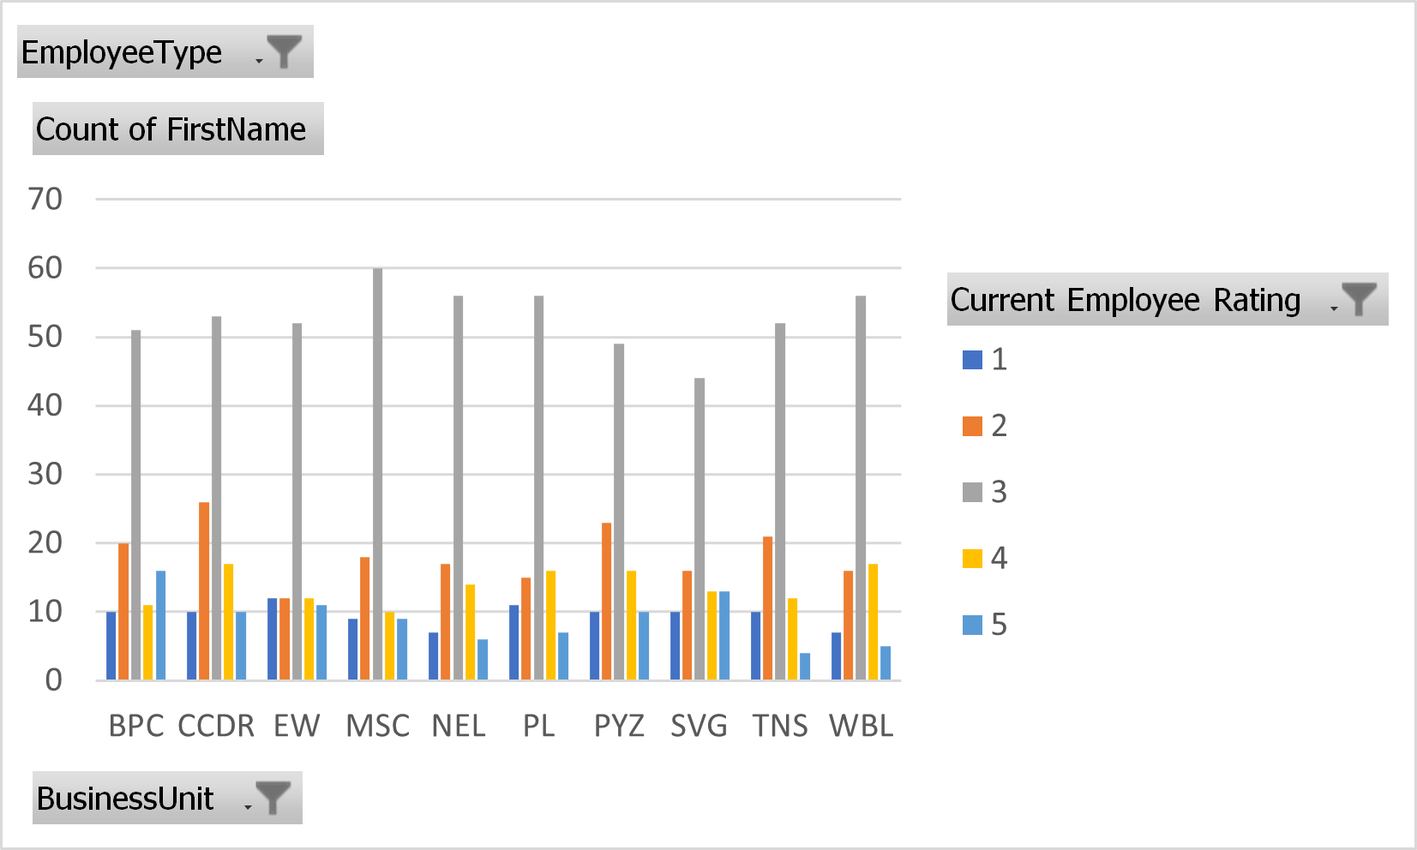
RESULTS
11

Slide 12
conclusion
An Employee Performance Analysis system is a strategic tool for optimizing workforce efficiency. By leveraging data-driven insights, businesses can make informed decisions, foster employee growth through personalized development plans, and improve overall productivity. This solution not only enhances employee engagement but also drives better business outcomes by aligning performance with organizational goals.

